Slide 1


Data Structures
ETCCDS202
Dr. Aarti
Faculty
School of Engineering & Technology
K.R. Mangalam University
Unit 2 : Linear Data Structures

Slide 2

Unit-2 Linear Data Structures
SESSION 11 Arrays – 1D & 2D
SESSION 12 Static & Dynamic Arrays
SESSION 13 Linked Lists Types
SESSION 14 Linked List Operations
SESSION 15 Stack ADT & Operations
SESSION 16 Stack Applications
SESSION 17 Queue ADT
SESSION 18 Queue Applications
SESSION 19 BFS using Queue
SESSION 20 Revision (Unit–2)
Notes:
New Courses replaced with New Programmes

Slide 3
Queue ADT
Session 17
Introduction to Queue ADT
Definition of Queue & FIFO Principle
Queue Terminology (Front & Rear)
Types of Queues (Linear, Circular, Priority, Deque)
Basic Queue Operations
Array Representation of Queue
Algorithms for Enqueue & Dequeue (Array)
Implementation of Queue Using Array (Python/C++)
Drawbacks of Array Implementation
Linked List Representation of Queue
Algorithms for Linked Queue Operations
Worked Example (Queue A → Queue B ordering)
Practice Problem
Key Takeaways
References
Notes:
New Courses replaced with New Programmes

Slide 4
Recapitulation (Stack Applications)
Stack is used for expression evaluation and conversion (infix, prefix, postfix).
It helps in function call management using the call stack.
It supports backtracking (e.g., Tower of Hanoi).
It is used to reverse data and check balanced parentheses.
Stack operations are efficient and mostly run in O(1) time per push/pop.
Notes:
New Courses replaced with New Programmes

Slide 5
Quick Quiz
Fill in the Blanks
Postfix expressions are evaluated using a __________.
Tower of Hanoi is solved using __________ and stack.
Stack stores function return addresses in the __________ stack.
Infix to postfix conversion uses a stack to store __________.
One-Word / Short Answer
Which notation places operator after operands?
Name one real-life application of stack.
Which principle is used by stack?
Which stack operation removes an element?
Application-based
Why is postfix preferred over infix for machine evaluation?
How does stack help in reversing a string?
Notes:
New Courses replaced with New Programmes

Slide 6
Quick Quiz (Answers)
Stack
Recursion
Call
Operators
Postfix
Undo/Redo / Browser history (any one)
LIFO
Pop
Because it avoids parentheses and precedence handling
By pushing characters and popping them in reverse order
Notes:
New Courses replaced with New Programmes

Slide 7
Learning Objectives
After this lecture, students will be able to:
Define Queue ADT and explain the FIFO principle
Identify queue components: front and rear
Describe different types of queues
Perform basic operations: enqueue, dequeue, peek, isEmpty, isFull
Explain overflow and underflow conditions in queues
Implement queue using arrays and linked lists
Write algorithms for queue operations
Analyze advantages and limitations of different implementations
Notes:
New Courses replaced with New Programmes

Slide 8
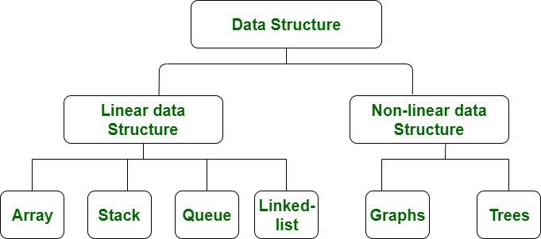
Data Structure
https://www.geeksforgeeks.org/data-structure-meaning/
Notes:
New Courses replaced with New Programmes

Slide 9

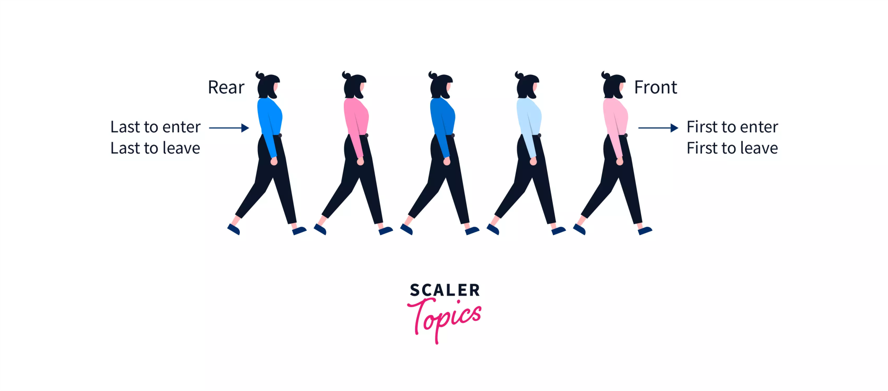
Structure of Queues?
Fig 1 : QUEUE
https://www.scaler.com/topics/data-structures/queue-in-data-structure/
Notes:
New Courses replaced with New Programmes

Slide 10
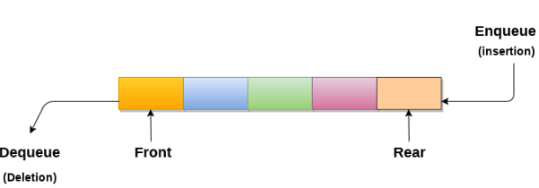
Queues?
An ordered list which enables insert operations to be performed at one end called REAR and delete operations to be performed at another end called FRONT.
Referred to be as First In First Out list.
https://www.javatpoint.com/data-structure-queue
Notes:
New Courses replaced with New Programmes

Slide 11
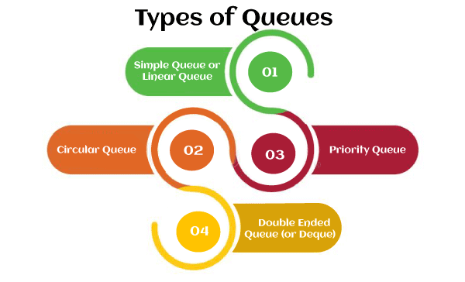
Types
https://www.javatpoint.com/data-structure-queue
Notes:
New Courses replaced with New Programmes

Slide 12
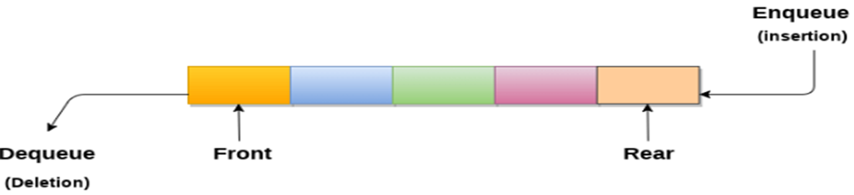
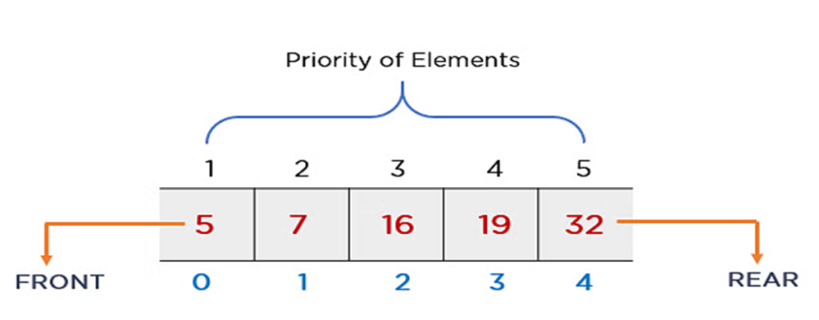
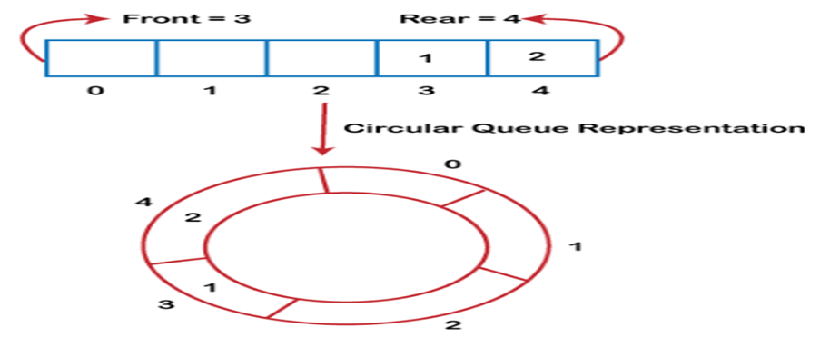
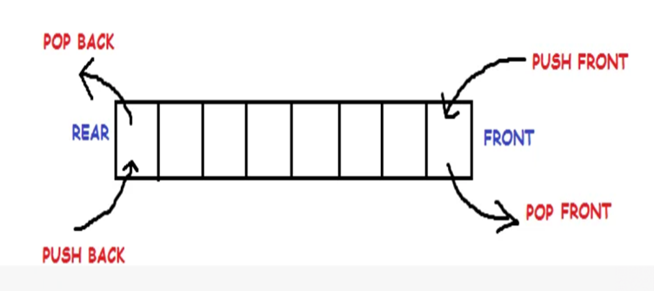
Types
https://www.javatpint.com/data-structure-queue
Notes:
New Courses replaced with New Programmes

Slide 13
Operations
Enqueue (Insert): Adds an element to the rear of the queue.
Dequeue (Delete): Removes and returns the element from the front of the queue.
Peek: Returns the element at the front of the queue without removing it.
isEmpty: Checks if the queue is empty.
isFull: Checks if the queue is full.
Notes:
New Courses replaced with New Programmes

Slide 14
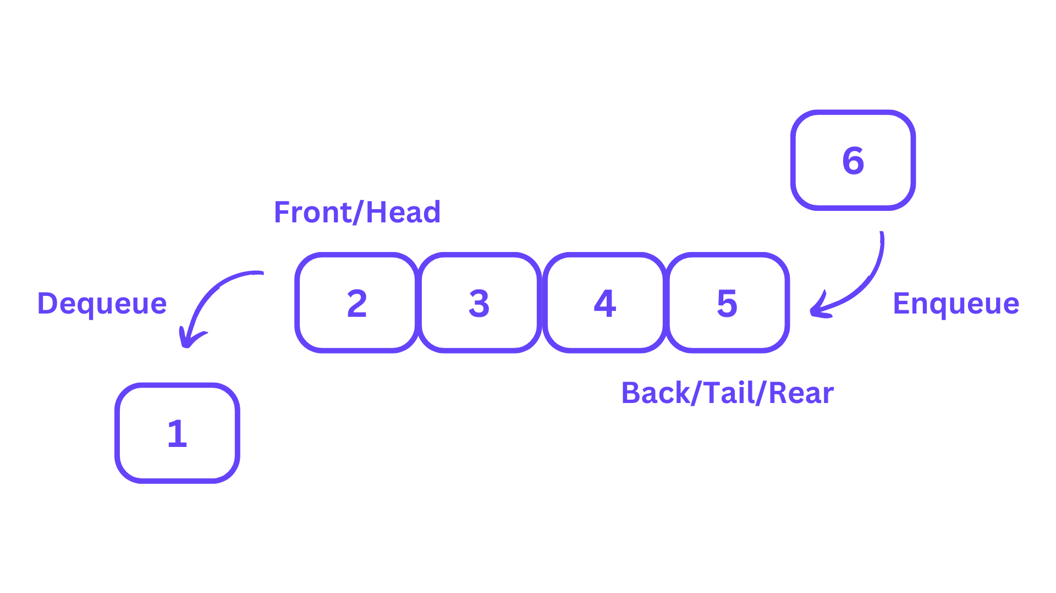
Operations
https://learnloner.com/queues-in-data-structures-and-algorithms-dsa/
Notes:
New Courses replaced with New Programmes

Slide 15
Check Your Understanding
Fill in the blanks
Queue follows the __________ principle.
Insertion in a queue is performed at the __________ end.
Deletion in a queue is performed from the __________ end.
The operation used to remove an element is called __________.
Short answer
What is queue overflow?
Name any one type of queue.
Notes:
New Courses replaced with New Programmes

Slide 16
Check Your Understanding (Answers)
FIFO
Rear
Front
Dequeue
Inserting into full queue
Circular / Priority / Deque.
Notes:
New Courses replaced with New Programmes

Slide 17
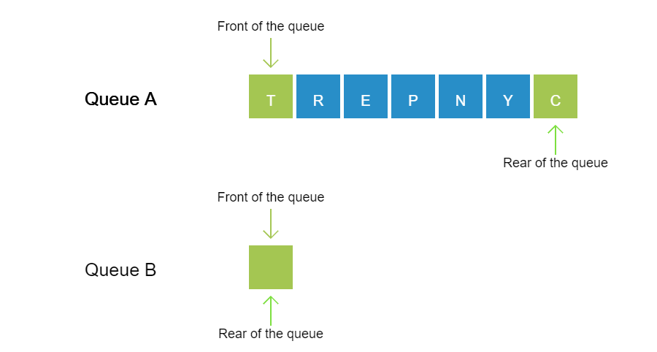
Working of Queue
Observe: The letters in the word "ENCRYPT" are stored in Queue A in a random manner. Observe the operations performed to display the letters in their correct order in Queue B so as to form the actual word.
Notes:
New Courses replaced with New Programmes

Slide 18
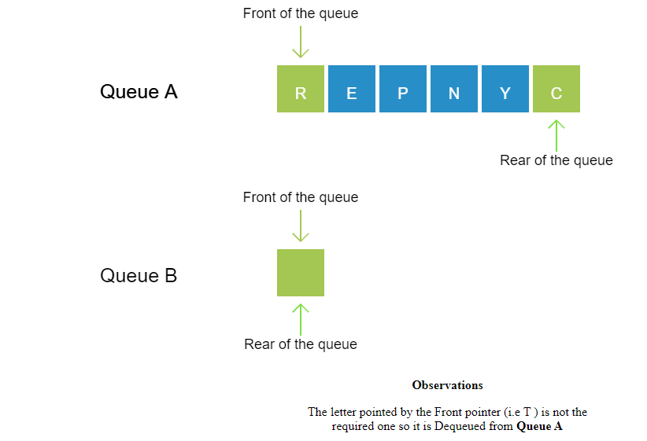
Notes:
New Courses replaced with New Programmes

Slide 19
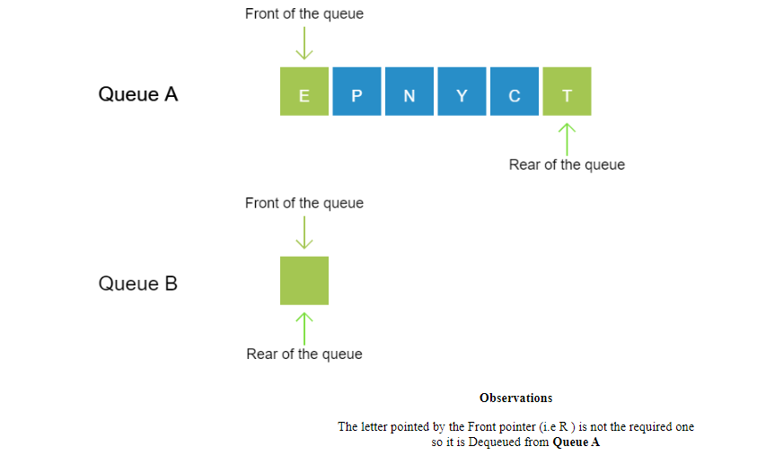
Notes:
New Courses replaced with New Programmes

Slide 20
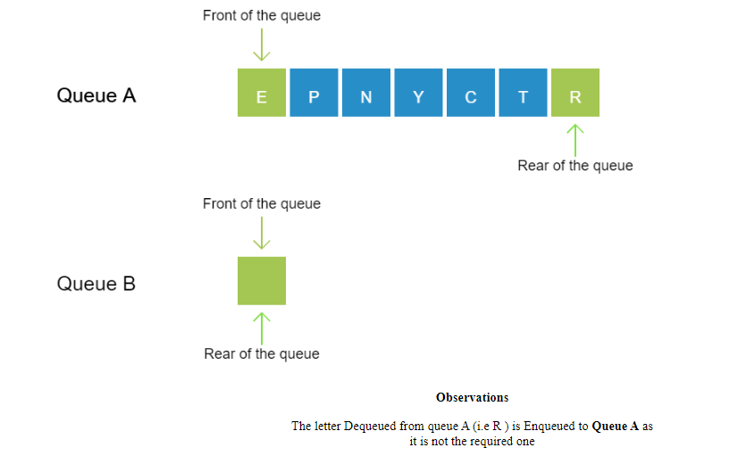
Notes:
New Courses replaced with New Programmes

Slide 21
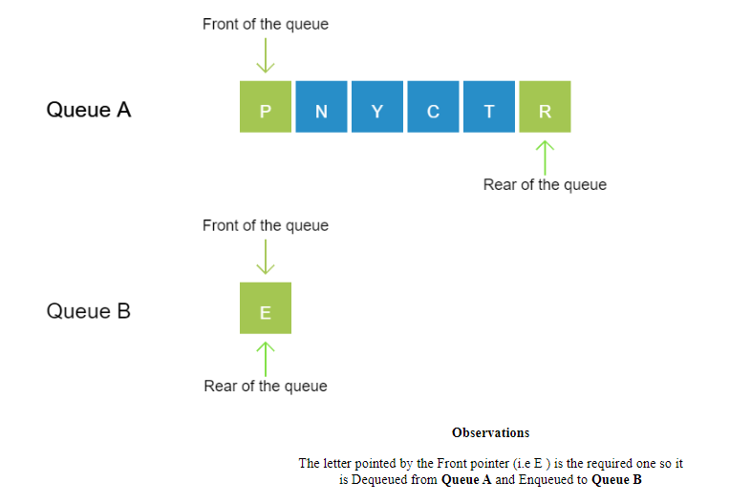
Notes:
New Courses replaced with New Programmes

Slide 22
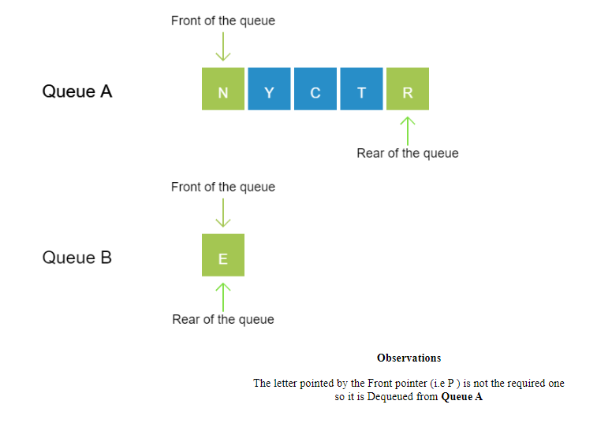
Notes:
New Courses replaced with New Programmes

Slide 23
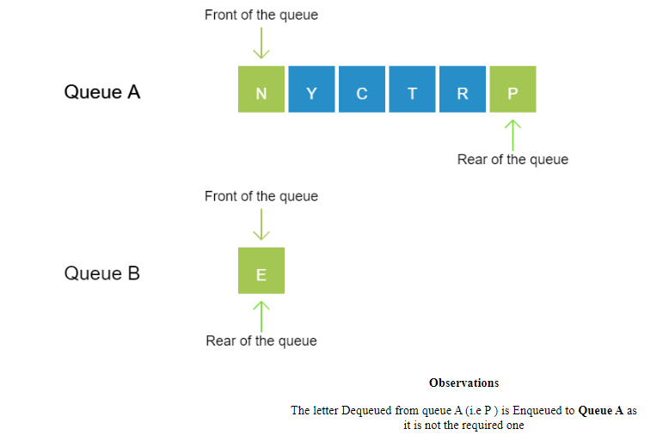
Notes:
New Courses replaced with New Programmes

Slide 24
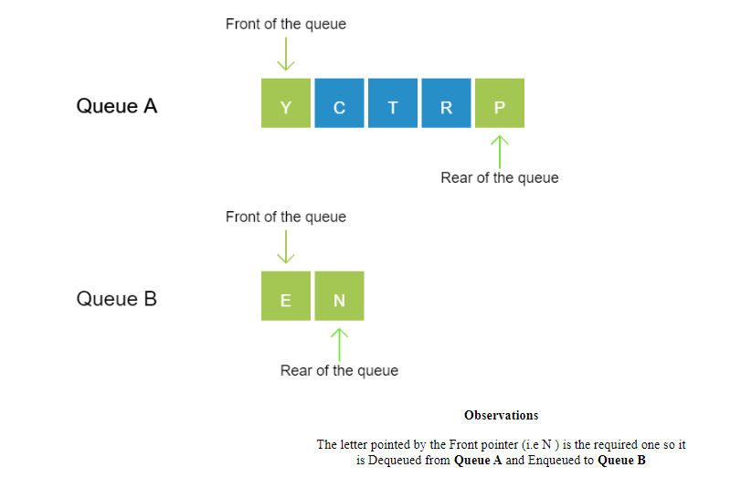
Notes:
New Courses replaced with New Programmes

Slide 25
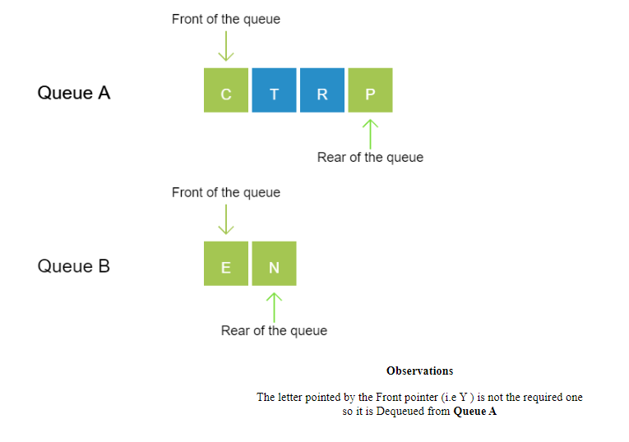
Notes:
New Courses replaced with New Programmes

Slide 26
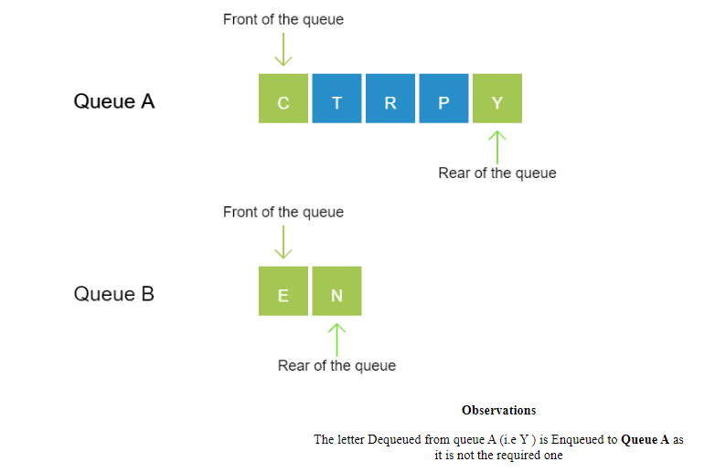
Notes:
New Courses replaced with New Programmes

Slide 27
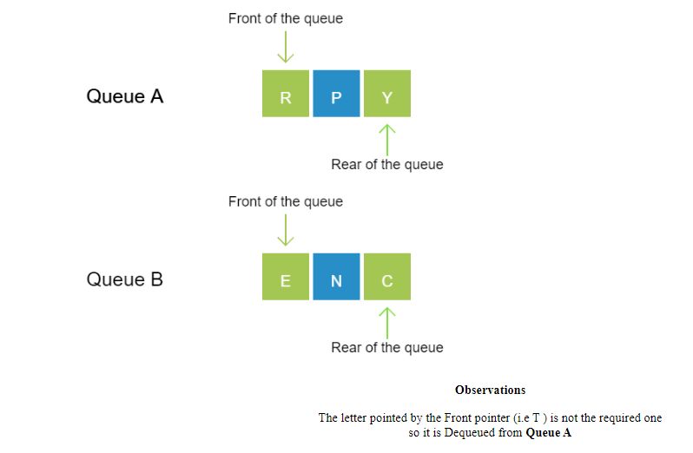
Notes:
New Courses replaced with New Programmes

Slide 28
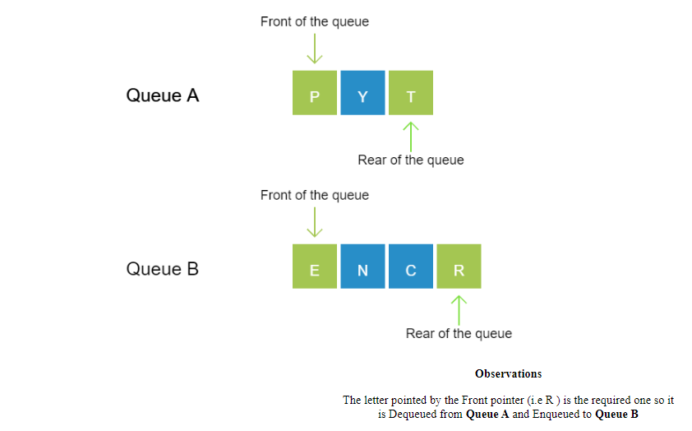
Notes:
New Courses replaced with New Programmes

Slide 29
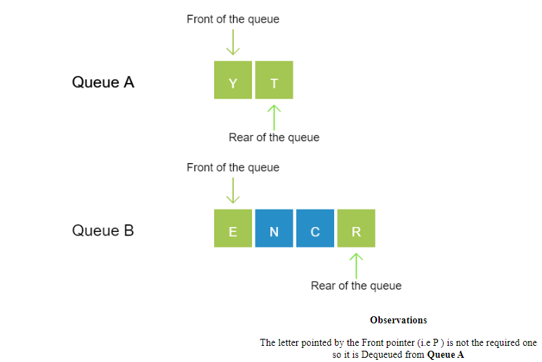
Notes:
New Courses replaced with New Programmes

Slide 30
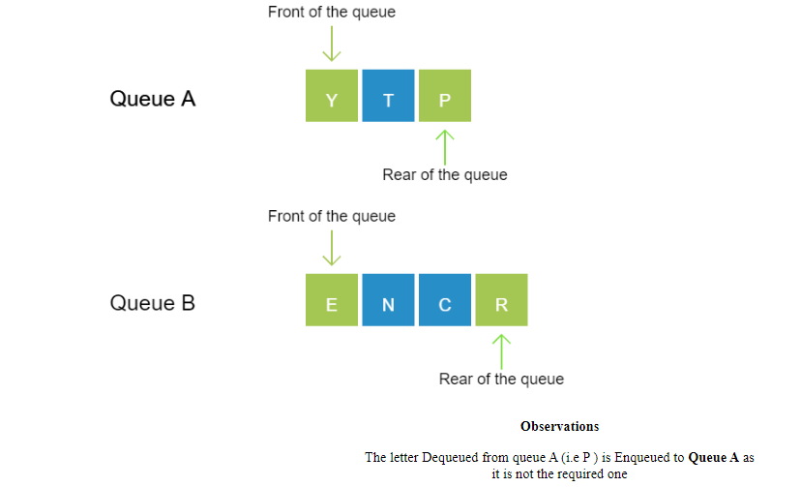
Notes:
New Courses replaced with New Programmes

Slide 31
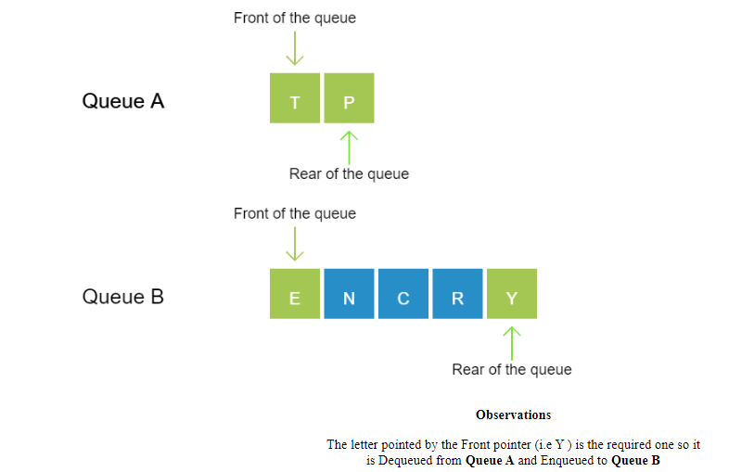
Notes:
New Courses replaced with New Programmes

Slide 32
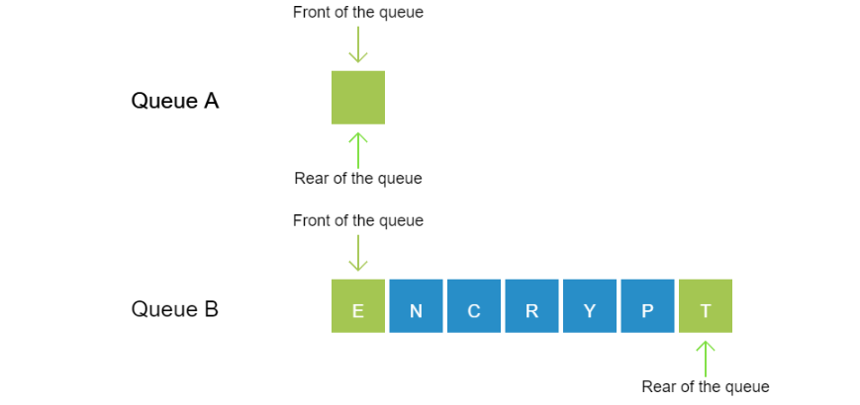
Notes:
New Courses replaced with New Programmes

Slide 33
Test Yourself
Which operation adds an element to the end of a Queue?
Enqueue
Dequeue
Peek
Push
Which operation removes an element from the front of a Queue?
Enqueue
Dequeue
Peek
Push
Notes:
New Courses replaced with New Programmes

Slide 34
Test Yourself
What happens when attempting to enqueue an element into a full Queue in an array-based implementation?
A. The element is added to the end of the Queue, expanding the size of the array.
B. The element is added to the end of the Queue, and the front element is removed.
C. The operation fails, as the Queue is full.
D. The element is added to the beginning of the Queue, shifting all elements one position to the right.
Notes:
New Courses replaced with New Programmes

Slide 35
Test Yourself
Which of the following data structures is typically used for the underlying implementation of Queues?
A. Arrays
B. Linked Lists
C. Stacks
D. Trees
What are the two primary operations performed on a Queue?
A. Insertion and Deletion
B. Searching and Sorting
C. Push and Pop
D. Enqueue and Dequeue
Notes:
New Courses replaced with New Programmes

Slide 36
Test Yourself
In an array-based implementation of a linear Queue, where is the front pointer initially positioned?
A. At the beginning of the array
B. At the end of the array
C. At a random position within the array
D. Not applicable, as arrays cannot be used to implement Queues
Notes:
New Courses replaced with New Programmes

Slide 37
(Answers)
A. Enqueue
B. Dequeue
C. Peek
A. O(1) for both enqueue and dequeue
C. The operation fails, as the Queue is full.
B. Linked Lists
D. Enqueue and Dequeue
A. At the beginning of the array
Notes:
New Courses replaced with New Programmes

Slide 38
Implementation of Linear Queues
Queue can be implemented using:
Arrays
Linked
Notes:
New Courses replaced with New Programmes

Slide 39
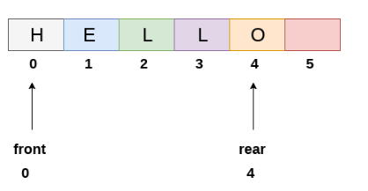
Array based implementation of linear Queues
https://www.javatpoint.com/array-representation-of-queue
Notes:
New Courses replaced with New Programmes

Slide 40
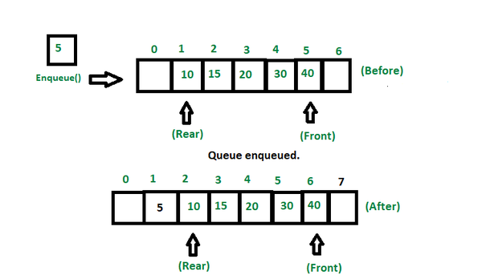
Enqueue Operations
Enqueue (Insert): Algorithm
Step 1: IF REAR = MAX - 1 Write OVERFLOW Go to step [END OF IF]
Step 2: IF FRONT = -1 and REAR = -1 SET FRONT = REAR = 0 ELSE SET REAR = REAR + 1 [END OF IF]
Step 3: Set QUEUE[REAR] = NUM
Step 4: EXIT
https://www.geeksforgeeks.org/basic-operations-for-queue-in-data-structure/
Notes:
New Courses replaced with New Programmes

Slide 41
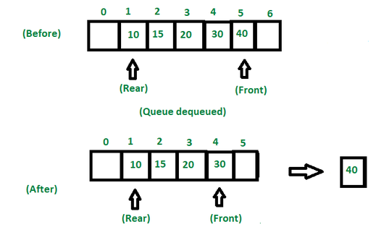
Dequeue Operation
Step 1: IF FRONT = -1 or FRONT > REAR Write UNDERFLOW ELSE SET VAL = QUEUE[FRONT] SET FRONT = FRONT + 1 [END OF IF]
Step 2: EXIT
https://www.geeksforgeeks.org/basic-operations-for-queue-in-data-structure/
Notes:
New Courses replaced with New Programmes

Slide 42
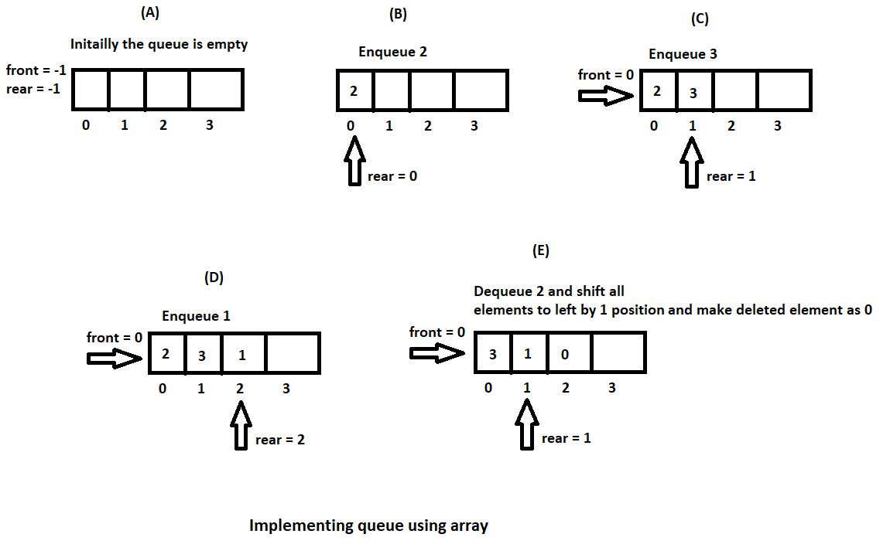
Implementation
https://hetalrachh.home.blog/2020/02/24/implementing-queue-using-array-in-java/
Notes:
New Courses replaced with New Programmes

Slide 43
Implementation
https://hetalrachh.home.blog/2020/02/24/implementing-queue-using-array-in-java/
Notes:
New Courses replaced with New Programmes

Slide 44
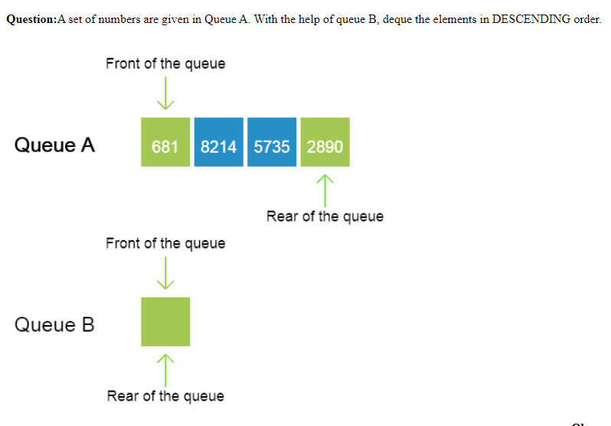
Practice
Question: A set of numbers are given in Queue A. With the help of queue B, deque the elements in DESCENDING order.
Notes:
New Courses replaced with New Programmes

Slide 45
Code for Queue Operations Using Array (Python)
# Queue implementation using array
queue = [0] * 100
n = 100
front = -1
rear = -1
def insert():
global front, rear
if rear == n - 1:
print("Queue Overflow")
else:
if front == -1:
front = 0
val = int(input("Insert the element in queue: "))
rear += 1
queue[rear] = val
def delete():
global front, rear
if front == -1 or front > rear:
print("Queue Underflow")
else:
print("Element deleted from queue is:", queue[front])
front += 1
def display():
if front == -1 or front > rear:
print("Queue is empty")
else:
print("Queue elements are:", end=" ")
for i in range(front, rear + 1):
print(queue[i], end=" ")
print()
Notes:
New Courses replaced with New Programmes

Slide 46
Code for Queue Operations Using Array (Python)
def main():
while True:
print("\n1) Insert element to queue")
print("2) Delete element from queue")
print("3) Display all the elements of queue")
print("4) Exit")
ch = int(input("Enter your choice: "))
if ch == 1:
insert()
elif ch == 2:
delete()
elif ch == 3:
display()
elif ch == 4:
print("Exit")
break
else:
print("Invalid choice")
if __name__ == "__main__":
main()
Notes:
New Courses replaced with New Programmes

Slide 47
Code for Queue Operations Using Array (C++)
#include <iostream>
using namespace std;
int queue[100], n = 100, front = - 1, rear = - 1;
void Insert() {
int val;
if (rear == n - 1)
cout<<"Queue Overflow"<<endl;
else {
if (front == - 1)
front = 0;
cout<<"Insert the element in
Notes:
New Courses replaced with New Programmes

Slide 48
Code for Queue Operations Using Array (C++)
queue : "<<endl;
cin>>val;
rear++;
queue[rear] = val;
}
}
void Delete()
{ if (front == - 1 || front > rear) {
cout<<"Queue Underflow "; return ;
} else {
cout<<"Element deleted from queue is : "<< queue[front] <<endl;
front++;; } }
Notes:
New Courses replaced with New Programmes

Slide 49
Code for Queue Operations Using Array (C++)
void Display()
{ if (front == - 1) cout<<"Queue is empty"<<endl;
else {
cout<<"Queue elements are : ";
for (int i = front; i <= rear; i++)
cout<<queue[i]<<" ";
cout<<endl; } }
int main()
{ int ch; cout<<“
1) Insert element to queue"<<endl; cout<<“
2) Delete element from queue"<<endl; cout<<
3) Display all the elements of queue"<<endl;
cout<<“
4) Exit"<<endl;
Notes:
New Courses replaced with New Programmes

Slide 50
Code for Queue Operations Using Array (C++)
do {
cout<<"Enter your choice : "<<endl; cin>>ch;
switch (ch)
{
case 1: Insert();
break;
case 2: Delete();
break;
case 3: Display();
break;
case 4: cout<<"Exit"<<endl;
break;
default: cout<<"Invalid choice"<<endl; } } while(ch!=4); return 0; }
Notes:
New Courses replaced with New Programmes

Slide 51
Output
Insert element to queue
Delete element from queue
Display all the elements of queue
Exit Enter your choice : 1
Insert the element in queue : 4
Enter your choice : 1
Insert the element in queue : 3
Enter your choice : 1
Insert the element in queue : 5
Enter your choice : 2
Element deleted from queue is : 4
Enter your choice : 3
Queue elements are : 3 5
Enter your choice : 7 Invalid
Notes:
New Courses replaced with New Programmes

Slide 52
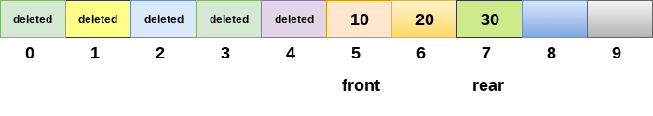
Drawback of array implementation
Memory wastage
Deciding the array size
Notes:
New Courses replaced with New Programmes

Slide 53
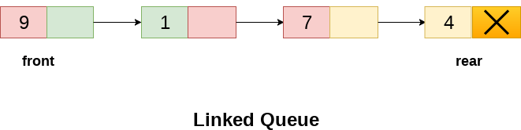
Implementation of Queue using Linked List
In a linked queue, each node of the queue consists of two parts i.e. data part and the link part.
Each element of the queue points to its immediate next element in the memory.
Notes:
New Courses replaced with New Programmes

Slide 54
Operation on Linked Queue
Insert operation
The new element will be the last element of the queue.
Firstly, allocate the memory for the new node ptr
ptr = (struct node *) malloc (sizeof(struct node));
There can be two scenarios of inserting this new node ptr into the linked queue.
Queues is empty
ptr -> data = item;
if(front == NULL)
{
front = ptr;
rear = ptr;
front -> next = NULL;
rear -> next = NULL;
}
Notes:
New Courses replaced with New Programmes

Slide 55
Operation on Linked Queue
2. The queue contains more than one element.
rear -> next = ptr;
rear = ptr;
rear->next = NULL;
Notes:
New Courses replaced with New Programmes

Slide 56
Algorithm for insert Operation on Linked Queue
Step 1: Allocate the space for the new node PTR
Step 2: SET PTR -> DATA = VAL
Step 3: IF FRONT = NULL SET FRONT = REAR = PTR SET FRONT -> NEXT = REAR -> NEXT = NULL ELSE SET REAR -> NEXT = PTR SET REAR = PTR SET REAR -> NEXT = NULL [END OF IF]
Step 4: END
Notes:
New Courses replaced with New Programmes

Slide 57
Delete Operation on Linked Queue
Deletion operation removes the element that is first inserted among all the queue elements.
ptr = front;
front = front -> next;
free(ptr);
Notes:
New Courses replaced with New Programmes

Slide 58
Algorithm for Delete Operation on Linked Queue
Step 1: IF FRONT = NULL Write " Underflow " Go to Step 5 [END OF IF]
Step 2: SET PTR = FRONT
Step 3: SET FRONT = FRONT -> NEXT
Step 4: FREE PTR
Step 5: END
Notes:
New Courses replaced with New Programmes

Slide 59
Check Your Understanding
1. Which operation adds an element to the end of a Queue?
A. Enqueue
B. Dequeue
C. Peek
D. Push
2. Which operation removes an element from the front of a Queue?
A. Enqueue
B. Dequeue
C. Peek
D. Push
Notes:
New Courses replaced with New Programmes

Slide 60
Check Your Understanding
3. What happens when attempting to enqueue an element into a full Queue in an array-based implementation?
A. The element is added to the end of the Queue, expanding the size of the array.
B. The element is added to the end of the Queue, and the front element is removed.
C. The operation fails, as the Queue is full.
D. The element is added to the beginning of the Queue, shifting all elements one position to the right.
4. Which of the following data structures is typically used for the underlying implementation of Queues?
A. Arrays
B. Linked Lists
C. Stacks
D. Trees
Notes:
New Courses replaced with New Programmes

Slide 61
Check Your Understanding
5. What are the two primary operations performed on a Queue?
A. Insertion and Deletion
B. Searching and Sorting
C. Push and Pop
D. Enqueue and Dequeue
6. In an array-based implementation of a linear Queue, where is the front pointer initially positioned?
A. At the beginning of the array
B. At the end of the array
C. At a random position within the array
D. Not applicable, as arrays cannot be used to implement Queues
Notes:
New Courses replaced with New Programmes

Slide 62
Check Your Understanding (Answers)
A. Enqueue
B. Dequeue
C. Peek
A. O(1) for both enqueue and dequeue
C. The operation fails, as the Queue is full.
B. Linked Lists
D. Enqueue and Dequeue
A. At the beginning of the array
Notes:
New Courses replaced with New Programmes

Slide 63
Key Takeaways
Queue is a linear data structure based on FIFO (First In, First Out).
Insertion happens at rear; deletion happens from front.
Main operations: enqueue, dequeue, peek, isEmpty, isFull.
Queue can be implemented using arrays or linked lists.
Array-based queue is simple but may cause memory wastage and fixed size issues.
Linked list implementation allows dynamic size.
Queue is widely used in CPU scheduling, networking, BFS, printer spooling, and more.
Notes:
New Courses replaced with New Programmes

Slide 64
References
Textbooks
Cormen, T. H., Leiserson, C. E., Rivest, R. L., & Stein, C., Introduction to Algorithms, MIT Press.
Lipschutz, S., Schaum’s Outline of Data Structures with C++, McGraw-Hill Education.
Reference Books
Weiss, M. A., Data Structures and Algorithm Analysis in C++, 5th Edition, Pearson Education.
Skiena, S. S., The Algorithm Design Manual, 3rd Edition, Springer.
Online Resources
GeeksforGeeks – Queue in Data Structures https://www.geeksforgeeks.org/queue-data-structure/
Scaler – Queue in Data Structures https://www.scaler.com/topics/data-structures/queue-in-data-structure/
JavaTpoint – Queue Data Structure https://www.javatpoint.com/data-structure-queue
Programiz – Queue in Python https://www.programiz.com/dsa/queue
TutorialsPoint – Queue Operations https://www.tutorialspoint.com/data_structures_algorithms/queue_algorithm.htm
Notes:
New Courses replaced with New Programmes

Slide 65
THANK YOU

